Slide 1
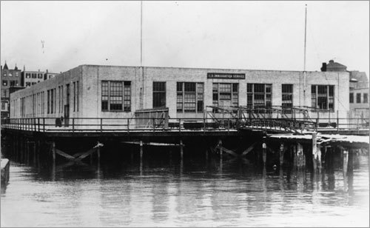
Tung Chin arrived in the United States in Boston in 1934.
What’s going on in America during the 1930s?

Slide 2
What do you know about and/or remember from analyzing advertisements about the 1920s in America?

Slide 3
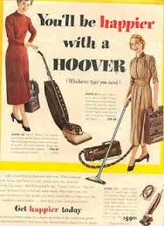
Notes:
Consumer goods of all kinds proliferated, marketed by salesmen and advertisers who promoted them as ways of satisfying Americans’ psychological desires and everyday needs. Frequently purchased on credit through new installment buying plans, they rapidly altered daily life. Telephones made communication easier. Vacuum cleaners, washing machines, and refrigerators transformed work in the home. Americans spend more and more of their income on leisure activities like vacations, movies, and sporting events. Radios and phonographs brought mass entertainment in to Americans’ living rooms. The automobile was the backbone of economic growth. The dollar replaced the British pound as the most important currency of international trade

Slide 4
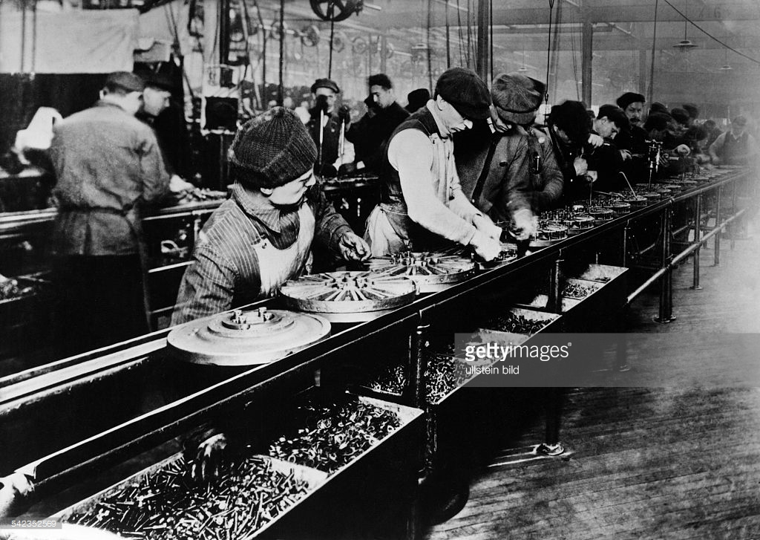
Henry Ford installs the first moving assembly line for the mass production of an entire automobile.
Notes:
His innovation reduced the time it took to build a car from more than 12 hours to two hours and 30 minutes.

Slide 5
1920s
The second industrial revolution
Explosion of manufacturing and production
+
Obsession with buying (mass consumerism of the 1920s)
BOOM: a period of great prosperity
Things are good
Notes:
In the 1920s there was an economic boom in the USA. In other words, things were really good economically. There are a number of reasons why there was a boom in the 1920s. The economic transformations that took place during the second industrial revolution created an explosion of manufacturing and production (a lot of stuff was being made). Americans also became obsessed with buying and a culture of mass consumerism (what you learned about in the last topic) emerged in America.
5

Slide 6
"This is our proudest boast: 'The American citizen has more comforts and conveniences than kings had two hundred years ago.'"
Samuel Strauss, 1924
Notes:
Observers from Europe, where class divisions were starkly visible in work, politics, and social relations, marveled at the comforts and conveniences of American life. As you read this, you should be mindful of what you learned about in earlier topics you explored about the widening gap between the wealthy and the poor (think Jacob Riis’s How the Other Half Lives, the widespread discrimination faced by African Americans, and the continued displacement and disregard for Native Americans).
6

Slide 7
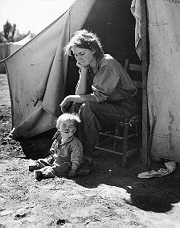
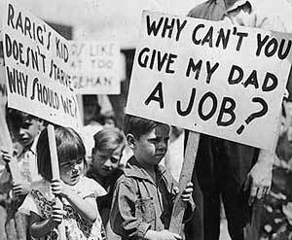
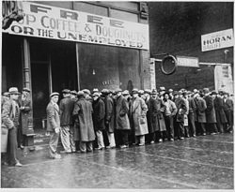
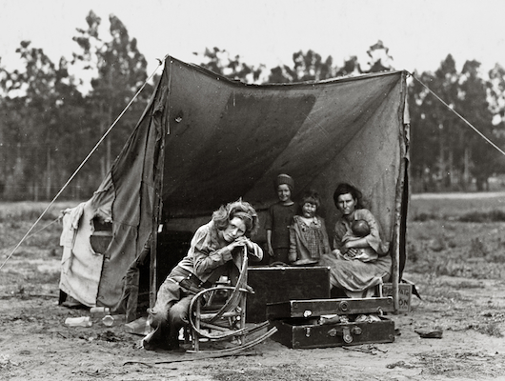
1929
THE GREAT DEPRESSION BEGINS
Notes:
The good ole days of the 1920s came to an abrupt end with in 1929, ushering in a period in American history known as the “Great Depression,” which is an odd named considering that there was nothing “great” about it, unless you like being poor and homeless. The Depression transformed American life. Hundreds of thousands of people took the road in search of work. Hungry men and women lined the streets of major cities. In Detriot, 4,000 children stood in bread lines each day seeking food. Thousands of families, evicted from their homes, moved into ramshackle shantytowns, dubbed Hoovervilles (named after U.S. President at the time Herbert Hoover who was blamed for not helping end the Great Depression), that sprang up in parks and on abandoned land.
7

Slide 8
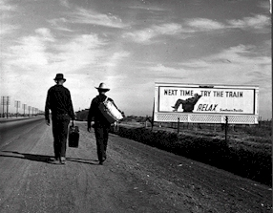
So what caused the Great Depression?
Duh…the STOCK MARKET CRASH
Notes:
So what caused the Great Depression? Most often, we point to the Stock Market Crash of 1929 as the number one reason the Great Depression occurred – which makes sense considering that the Stock Market Crash of 1929 happened right before the Great Depression officially began. And yet, there were signs of economic problems well before 1929.
8

Slide 9
Earlier Problems??
Stock Market Crash
Great Depression
Notes:
The Stock Market Crash was like the last domino in a long line of dominos that had been falling towards disaster for decades.
9

Slide 10
So what caused the Great Depression?
The most notable sign of the troubled economy or the “great” depression.
UNEMPLOYMENT
-Over 25% of people could not find jobs.
Why was there UNEMPLOYMENT?
Notes:
10

Slide 11
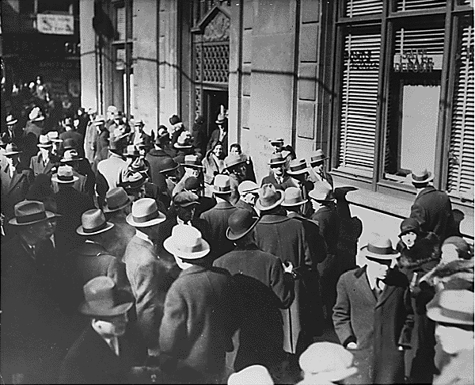
Wow! Look at these lines. Is it usually like this?
No stupid, the bank is closed!d
Notes:
The vast majority of banks in America were small. People deposit (put) there money in banks, but their money doesn’t necessarily stay there. The bank also uses that money to give out loans – with the hope that people will pay them back. The bank makes money because what we call interest is added to that loan. The longer it takes someone to pay back the loan the more interest that is added to the final balance. When there was a panic and people rushed to withdrawl money, the banks did not have the money to pay everyone back. Today there is something called the Federal Reserve that prevents this from happening. But, that is a story for another day.
11

Slide 12
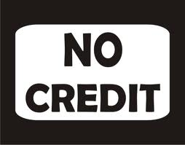
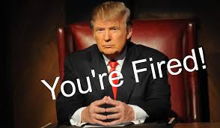
Bank closures
No loans = less money circulating
Less money to buy things!
Deflation = drop in all prices
Business have to fire people.
Notes:
When prices drop, business that can’t sell their products cut costs (save money) by laying of workers (firing people). These workers can therefore not buy anything and prices drop further. In turn, businesses have more products than they can sell. Banks were not lending money so more and more businesses couldn’t pay their workers, so they had to let even more workers go (fire them). And this downward spiral continued and continues until employment was at an all time high.
12

Slide 13
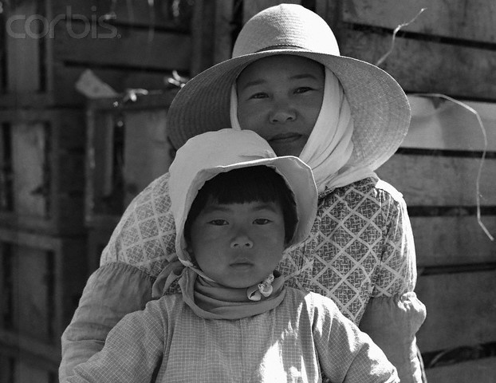
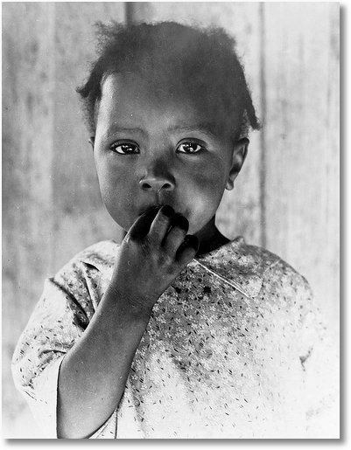
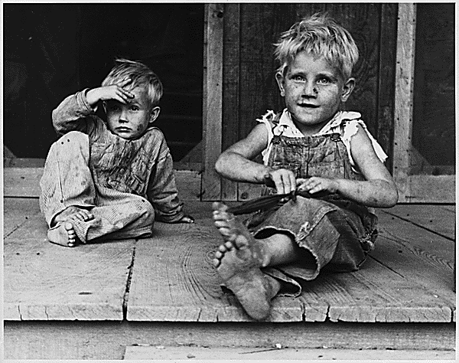
Let’s not blame it all on the BANKS!!
Mass consumerism (obsession with buying) of
the 1920s led factories to overproduce or
make more goods than were sold.
Lack of government interference in the economy?
Notes:
While the nationwide banking crisis played a large role in causing the Great Depression, there were other economic concerns that surfaced during the 1920s that most likely contributed to the economic demise. The mass consumerism that emerged during the 1920s led many factories to produce more products than people could buy. And, what people were buying was being bought on credit (money they really didn’t have). I also think that it is important to consider how the lack of government intervention in the economy may also be to blame. For decades, the U.S. believed in the idea known as laissez-faire – perhaps the Great Depression indicated that at least some government intervention in the economy was perhaps necessary.
13

