Slide 1
Foreign Policy #1: Truman Doctrine
WHOLE CLASS EXPERIENCE

Slide 2
TRUMAN DOCTRINE = CONTAIN COMMUNISM
What was the U.S. government willing to do in order to “contain communism?”
Contribute billions of dollars to finance the economic recovery of Europe
Create new securities organizations (National Security Council and CIA) to gather intelligence and conduct secret operations abroad.
Deny Americans their civil liberties
Go to WAR?

Slide 3
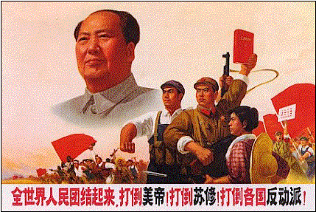
1949 – communists led by Mao Zedong win Chinese civil war.
and
the Soviet Union tests its first atomic bomb!!

Slide 4
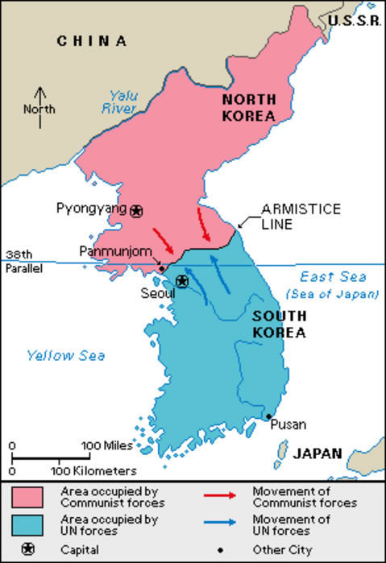
The Korean War (1950-1953)
Background Info:
After WWII – Korea divided into two zones (north controlled by the Soviet Union - south by the U.S.
How the war started?
NK army invades the south
To “contain” communism, Truman receives permission to use force to repel the invasion.

Slide 5
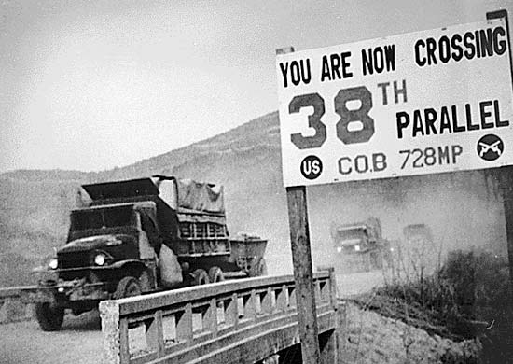
In the end…
Stalemate at the 38th parallel and
33,000 Americans died
1 million Korean soldiers
2 million Korean civilians

Slide 6
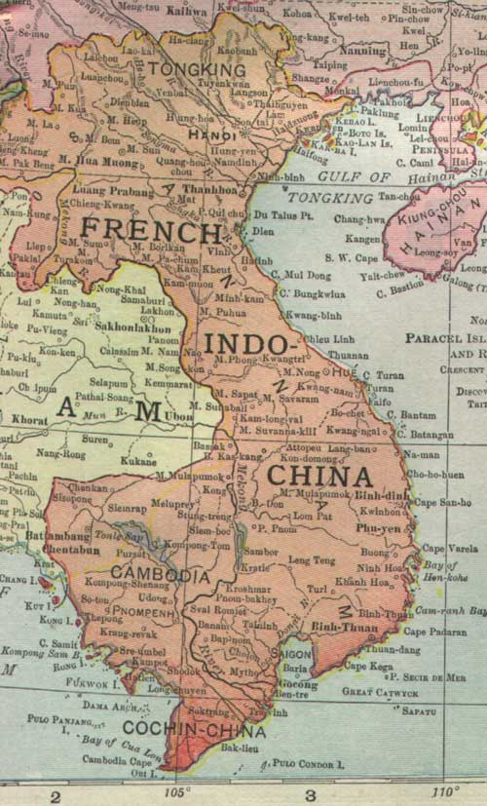
The Vietnam War (1964-1975)
Background Info:
Before WWII = French colony
During WWII = Occupied by Japan
After WWII = Viet Minh, a communist army, wins independence.
U.S. hoping once again to “contain” communism finances the creation of a pro-American South Vietnamese govt. in 1954.

Slide 7
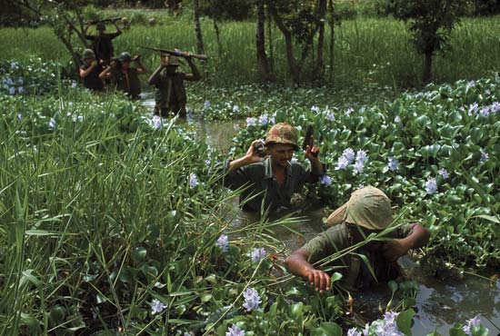
How the war started?
North Vietnamese (supported by the Soviet Union) fight against the South Vietnamese (supported by the U.S.)
South is losing and after a N.V. patrol boat fires on an American ship– Congress passes the “Gulf of Tonkin Resolution” giving the president power to declare war
U.S. sends troops to Vietnam for more than ten years.

Slide 8
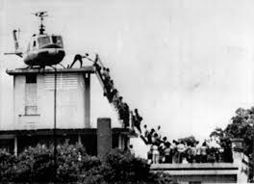
In the end…
North Vietnamese wins!!
58,000 Americans died
3-4 million Vietnamese died
1973 - War Powers Act (President must have congressional approval to send troops abroad.

Slide 9
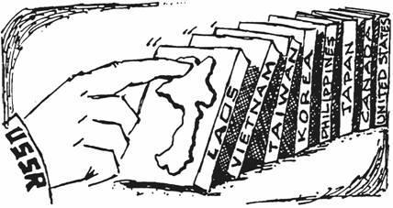
All in the name of “containment”!
Domino theory = if one country in a region came under the influence of communism, then the surrounding countries would follow

